Slide 1
Accelerating Better Outcomes
Lead the Way | January 16, 2024

Slide 2
Meet Our Company
Our purpose is to accelerate better health outcomes through quality healthcare
With over six decades of combined experience, CNSI and Kepro have come together to become:
Our vision is to be the vital partner for healthcare solutions in the public sector
Our mission is to continually innovate solutions that deliver maximum value and impact to those we serve

Slide 3
NCLIFTSS Team
JOHN HENNESSEY | VICE PRESIDENT, OPERATIONS, NCLIFTSS
___________________
LYNEKA JUDKINS | EXECUTIVE DIRECTOR, NCLIFTSS PROGRAM
_________________
Genevieve MerriTT | Clinical Director, NCLIFTSS Program
__________________
VERONICA cRUZ | STAKEHOLDER Engagement & education coordinator, NCLIFTSS PROGRAM

Slide 4
AGENDA
Transitions to NCLIFTSS and Current Status
The Realignment of PCS: Phase I and II
Managing Provider Questions and Concerns
Q & A: Questions will be responded to and discussed after the presentation.

Slide 5
Transitions to NCLIFTSS and Current Status
June 2023: Kepro was awarded the Comprehensive Independent Assessment Entity contract to conduct assessments and oversee transition services for Medicaid LTSS members.
Kepro is now doing business as Acentra Health.
Quality Assurance Oversight
Update on the Backlog

Slide 6
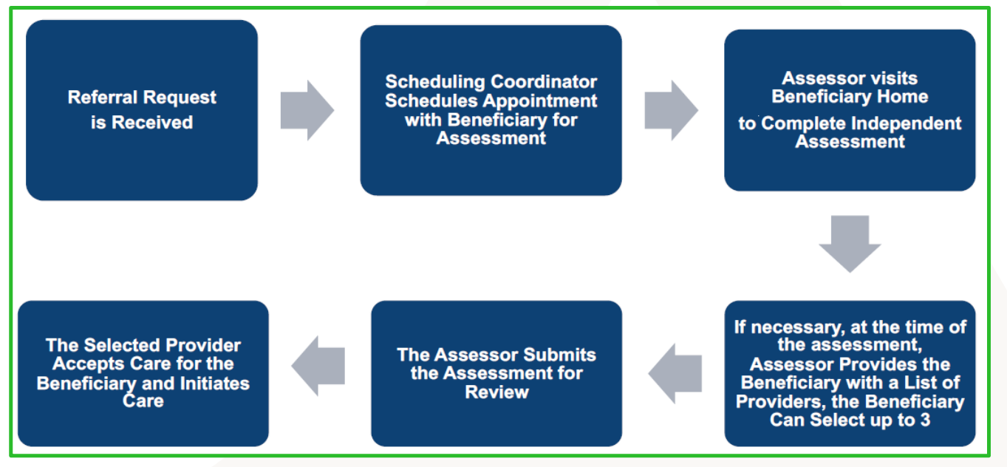
Scheduling and Conducting Initial Assessments

Slide 7
Scheduling and Conducting Initial Assessments
The eligibility assessment, or independent assessment (IA), will be conducted by a clinical assessor using an assessment tool approved by NC Medicaid.
The clinical assessor will combine observation, interviews, and simulation of Activities of Daily Living (ADLs), and review of beneficiary records to determine eligibility for PCS.

Slide 8
Managing Provider Questions and Concerns
Medicaid Managed Care Provider Ombudsman:
Phone: 866-304-7062
Email: Medicaid.ProviderOmbudsman@dhhs.nc.gov
NC Tracks Call Center: 800-688-6696 (Billing and Claims Issues)
VieBridge Support Center ( QiRePort Issues)
Call 888-705-0970
Email: support@QiRePort.net.

Slide 9
Questions? Call Acentra Health: 833-522-5429 (toll free) or 919-568-1717.
Call Center open Monday-Friday 8:00am to 5:00pm
Fax (for all required forms): 833-470-0597
Email address: NCLIFTSS@Kepro.com
Frequently Asked Questions Regarding PCS: NCliftss | PCS (kepro.com)
PCS Forms and Policies: PCS-Forms (kepro.com)

Slide 10
Overview of PCS Realignment
Phase I:
Rate methodology change for congregate settings to a daily rate
Standalone policies for primary private residences and congregate settings
Effective date January 1, 2024
Phase II:
- Workgroups in four functional areas
- Recommendations from workgroup to NC Medicaid leadership
- Final recommendations to General Assembly for review and next steps
- Timeline – January – April 2024

Slide 11
Questions & Answers

Slide 12
Survey Link
https://forms.office.com/g/kpVKGh7PG3
Email Contact: NCLIFTSS@Kepro.com

